Slide 1
1. What is Complexity?
Complexity refers to the rate at which the required storage or consumed time grows as a function of the problem size.
The absolute growth depends on the machine used to execute the program, the compiler used to construct the program, and many other factors.
We would like to have a way of describing the inherent complexity of a program (or piece of a program), independent of machine/compiler considerations.
Data Structure BY S.R. Sharma

Slide 2
Cont..
This means that we must not try to describe the absolute time or storage needed.
We must instead concentrate on a “proportionality” approach, expressing the complexity in terms of its relationship to some known function. This type of analysis is known as asymptotic analysis.
Data Structure BY S.R. Sharma

Slide 3
Asymptotic analysis
Asymptotic analysis is based on the idea that as the problem size grows, the complexity can be described as a simple proportionality to some known function. This idea is incorporated in the
1. .“Theta”
2. “Big O”,
3 “Omega” and
3notation for asymptotic performance.
Data Structure BY S.R. Sharma

Slide 4
1.The Θ-Notation (Tight Bound) theta notation
This notation bounds a function to within constant factors. We say f(n) = Θ(g(n)) if there exist positive constants n₀, c₁ and c₂ such that to the right of n₀ the value of f(n) always lies between c₁g(n) and c₂g(n), both inclusive. The Figure below gives an idea about function f(n) and g(n) where f(n) = Θ(g(n)) . We will say that the function g(n) is asymptotically tight bound for f(n).
Data Structure BY S.R. Sharma

Slide 5
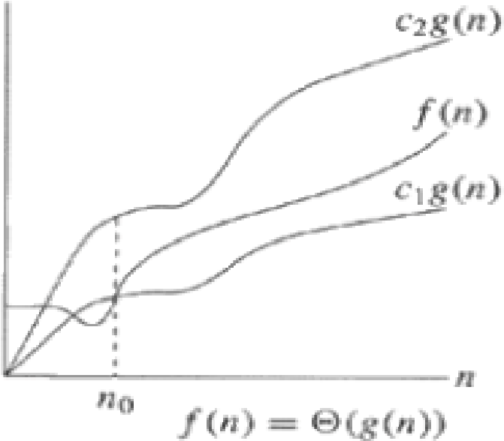
Cont..
Data Structure BY S.R. Sharma

Slide 6
2. The big O notation (Upper Bound)
Big O” notation
This notation gives an upper bound for a function to within a constant factor. Figure below shows the plot of f(n) = O(g(n)) based on big O notation. We write f(n) = O(g(n)) if there are positive constants n₀ and c such that to the right of n₀, the value of f(n) always lies on or below cg(n).
Data Structure BY S.R. Sharma

Slide 7
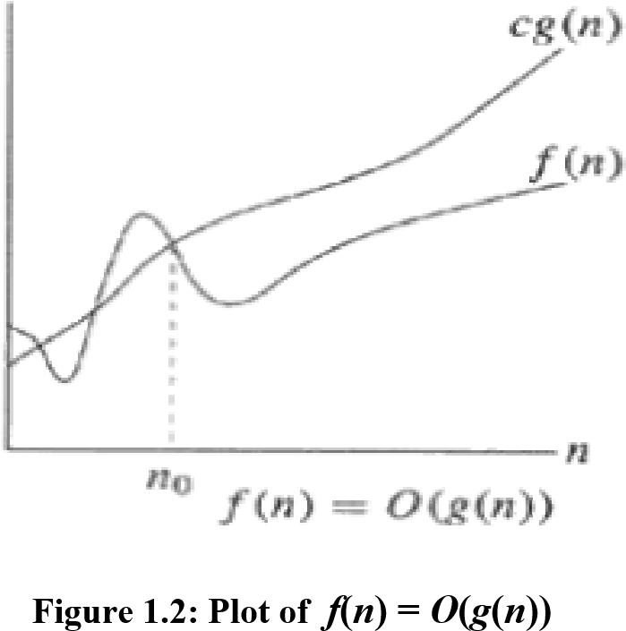
Cont..
Data Structure BY S.R. Sharma

Slide 8
3. The Ω-Notation (Lower Bound)
"Omega”
This notation gives a lower bound for a function to within a constant factor. We write f(n) = Ω(g(n)), if there are positive constants n₀ and c such that to the right of n₀, the value of f(n) always lies on or above cg(n). Figure 1.3 depicts the plot of f(n) = Ω(g(n)).
Data Structure BY S.R. Sharma

Slide 9
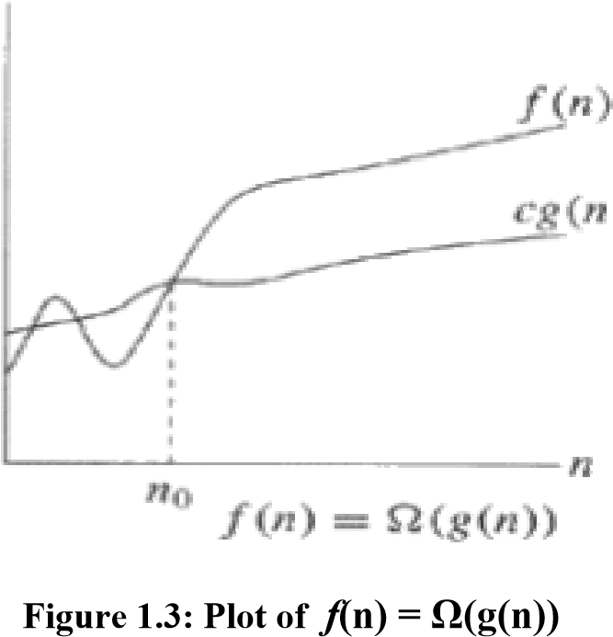
Cont..
Data Structure BY S.R. Sharma

Slide 10
model
In order to analyze algorithm in a formal frameworks, we need a model of computational. The model is basically a normal computer, in which instructions executed sequentially. In models we have standard simple instructions such as additional, multiplication, comparison, and assignments, but unlike the case with real computers, it takes exactly one time unit to do anything.
Data Structure BY S.R. Sharma

Slide 11
Running time calculations
Example
int sum (int n)
{
int i, partialsum;
1 partialsum=0; 1unit
2 for(i=0;i<-n;i++)
3 partialsum+=i*i*i; 4units its goes up to n so 4n
4 return partialsum; 1unit
}
Data Structure BY S.R. Sharma

Slide 12
Cont..
The analysis of above program is simple. The declaration count for no times. Line 1 and 4 count for one unit each. Line 3 counts for four units per time executed(two multiplication, one addition, and one assignments) and is executed N times for total 4N. Line 2 has the hidden costs of initializing i, testing i<=N, tests, and N for all the increments, which is 2N+2. we ignore the cost of calling function and returning, for total of
4N+2+2N+2 = 6N +4
Total time is 6N+4 units.
Data Structure BY S.R. Sharma

Slide 13
THANK YOU
Data Structure BY S.R. Sharma

